Slide 1

IOT – PBBT Team
IOT Monitoring Camera
Valentin EYRAUD
Julian NDENDE
Louis-Quentin AMSELLEM
Baptiste ALLEX
Arnaud HO-CHOUCK
Antoine VAN GORP

Slide 2
Summary :
I/ Real-Time Face Detection Using IoT
II/ Team Members and Roles
III/ Project Ideation and Evolution
IV/ Technical Architecture
V/ Challenges and Solutions
VI/ Project Results
VII/ Demo
VIII/Technical Information
IX/ Conclusion

Slide 3
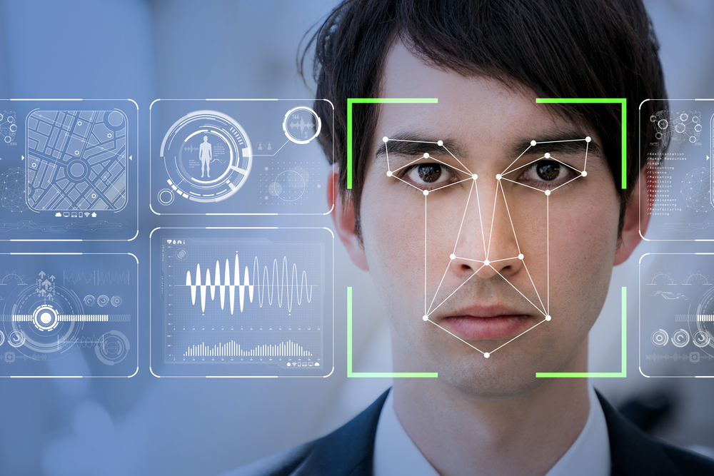
I/ Real-Time Face Detection Using IoT
Project Purposes and Goals

Slide 4
II/ Team Members and Roles
Our roles in the project
Individual contributions and collaboration
- Valentin EYRAUD : Team Leader and Developer
- Julian NDENDE : Surveyor and Developer
- Louis-Quentin AMSELLEM : Facilitator and Developer
- Baptiste ALLEX : Presenter and Developer
- Arnaud HO-CHOUCK : Recorder and Developer
- Antoine VAN GORP : Process Observer and Developer

Slide 5
III/ Project Ideation and Evolution
Outcome of brainstorming sessions
Evolution of our idea and the decision making process

Slide 6
IV/ Technical Architecture
Hardware Components : Raspberry Pi, Camera
Software used : Python, OpenCV…
Implementation steps

Slide 7
V/ Challenges and Solutions
Model precision detecting screens as Human
Improving model and setting up the confidence
Sending screenshots constantly when a person was found
Adding a timer that send one screenshot each 30 seconds

Slide 8
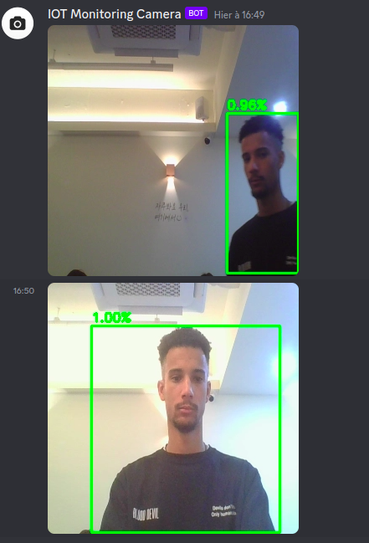
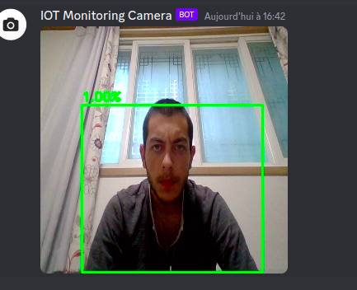
VI/ Project Results

Slide 9
VII/ Demo
Different cases for the demo (4 examples):
Light effect example
Dark effect example
Basic example

Slide 10
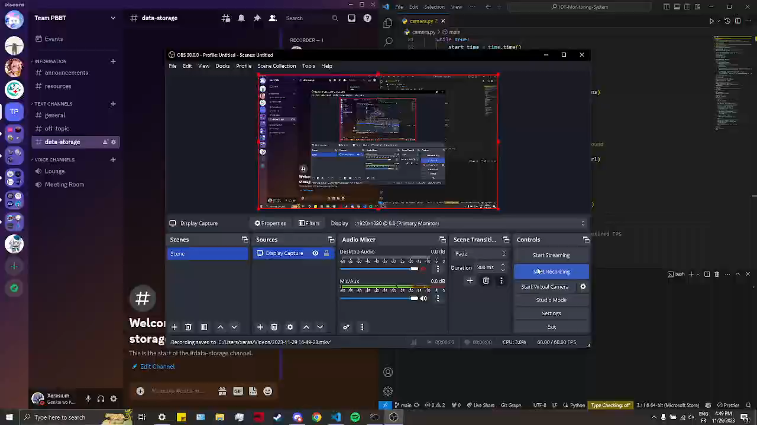
Basic case

Slide 11
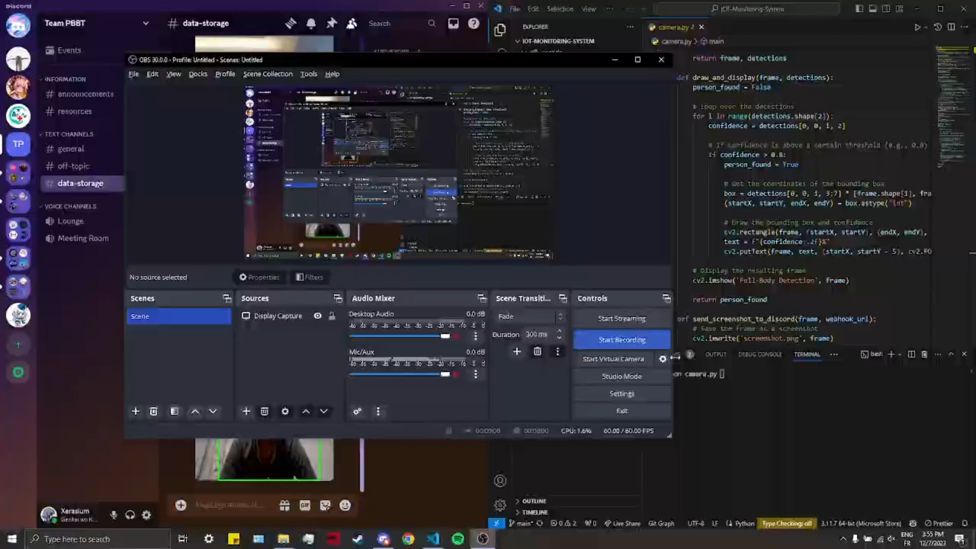
Lights adjustment

Slide 12
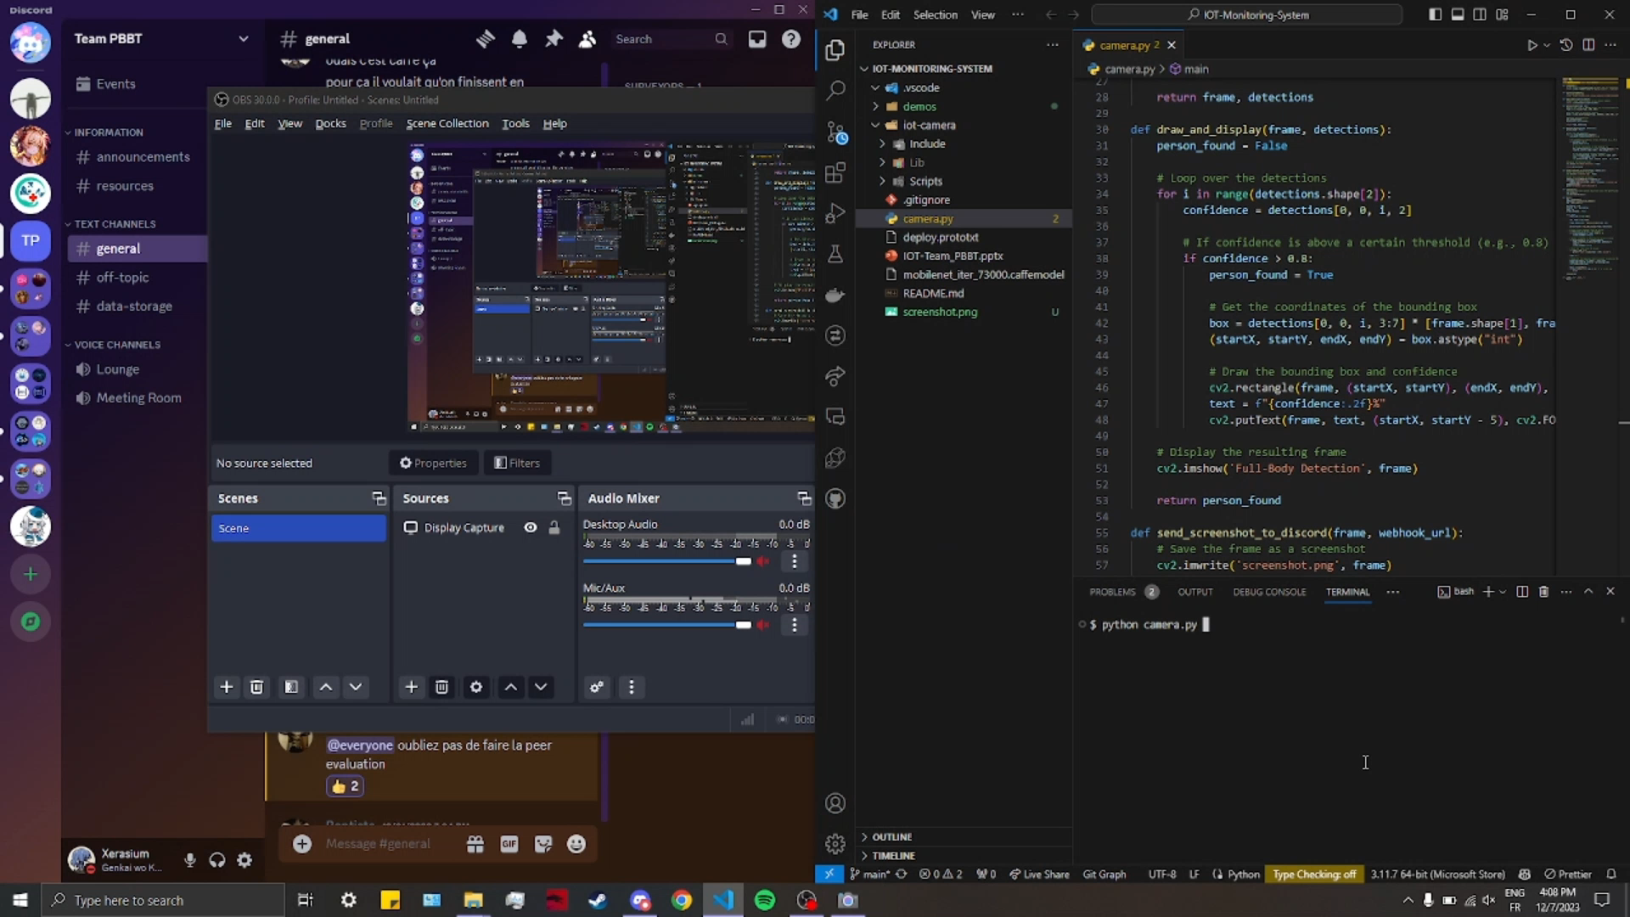
Lights adjustment

Slide 13
VIII/ Technical Information
Start of the program
Start timers
Person detection process
Render accuracy and box detection
Send screenshot on discord
(using discord webhook package)
Repeat
Reset timers

Slide 14
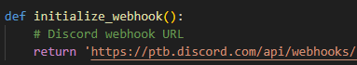
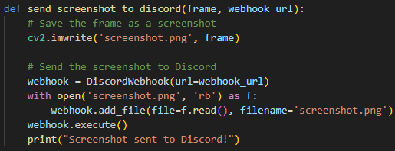
VIII/ Technical Information
How the sending method work:
Defining the link to your discord chat on which you want the screens to be sent
During the loop we save the detected frame has a file locally first and using the webhook package we send this frame to the wehbook link of our discord channel

Slide 15
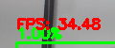
VIII/ Technical Information
Raspberry PI:
Local FPS: ~10
Local FPS during processing: ~5
On PC:
Local FPS: ~60
Local FPS during processing: 25-40

Slide 16


IX/ Conclusion

